Slide 1
Environmental Flow Issues in Ganga Basin
By
N.N.Rai
Director, Hydrology
Central Water Commission

Slide 2
Environment flow
Environmental flows is an ecologically acceptable flow regime designed to maintain a river in an agreed or predetermined state
All components of the hydrological regime have certain ecological significance
High flows of different frequency are important for channel maintenance, bird breeding, wetland flooding and maintenance of riparian vegetation
Moderate flows may be critical for cycling of organic matter from river banks and for fish migration
Low flows of different magnitudes are important for algae control, water quality maintenance and the use of the river by local people.

Slide 3
Drainage area map of Ganga

Slide 4
Rainfall scenario in Ganga basin

Slide 5
Important facts
Drainage area of Ganga basin in India 861452 sq.km
(26% of GA of India)
Mean annual runoff (MAF) 525.02 BCM
Glacier runoff 3% of MAF
(Source: IWMI RR 150)
Seasonal snow melt 1% of MAF
(Source: IWMI RR 150)
Utilizable surface water resources in India 690 BCM
Utilizable GW resources in India 431 BCM
Utilizable surface water resources in Ganga basin 250 BCM (36%)
Replenishable GW resource in Ganga basin 170.99 BCM
Population in Ganga basin (yr 2010) 505.54 million
Per capita water availability in Ganga basin (yr 2010) 1039 cubic meter <1700
Live storage created so far in Ganga basin 48.748 BCM
Live storage in projects under construction 7.703 BCM

Slide 6
India is Water Scarce: and is moving towards an ‘Absolute Water Scarcity’

Slide 8
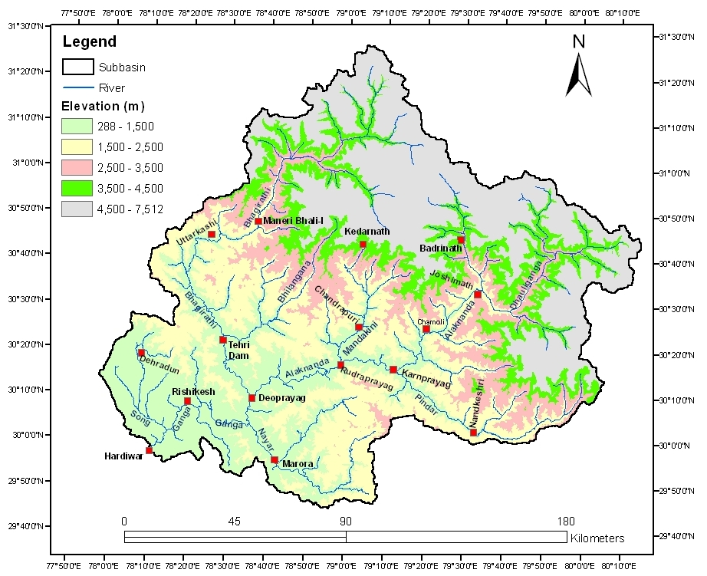
Himalayan Ganga
Hardwar -23029 sq.km
Deoprayag-19600 sq.km
Rudraprayag-10675 sq.km
Joshimath – 4508 sq.km
Tehri – 7208 sq.km

Slide 9
Average annual rainfall pattern of Himalayan Ganga
Avg annual yield of Ganga at Rishikesh : 24.63 BCM, Nov-Apr : 3.48 BCM

Slide 10
Avg monthly Flow pattern in Himalayan Ganga

Slide 11
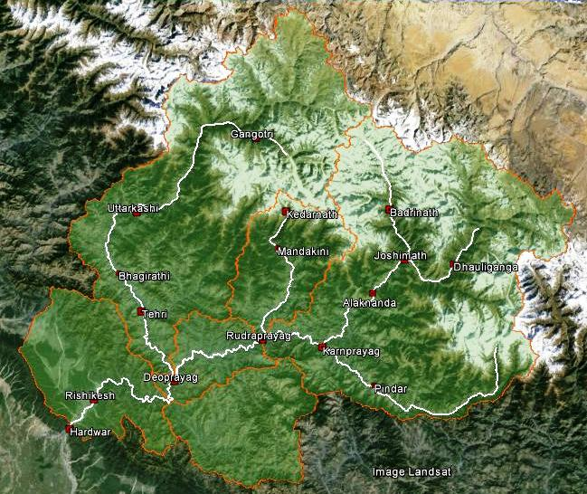
Avg monthly non-monsoon flow pattern in Himalayan Ganga
The minimum monthly flows at different locations are about 25 to 50% of the average monthly flow

Slide 12
Pre and Post Tehri flow pattern at Rishikesh
Tehri dam commissioned in July 2006, Multipurpose project (3.54 BCM Gross, 2.615 BCM live storage, provision of 2.70 lakh ha additional irrigation, stabilization of 6.04 lakh ha command in U.P., Drinking water 162 MGD to Delhi, 108 MGD to U.P., 1000 MW power

Slide 13
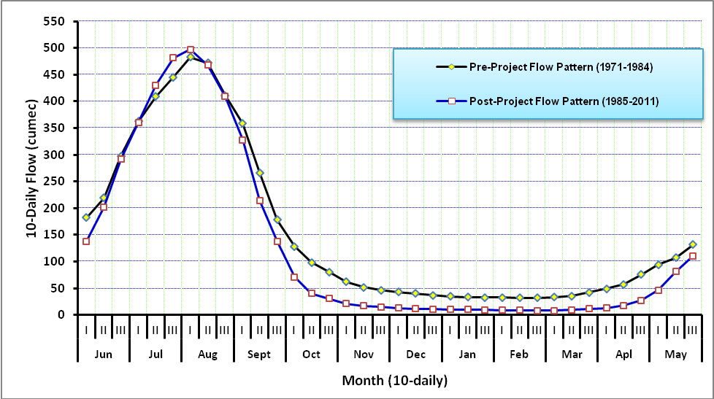
Pre and Post Maneri Bhali flow pattern at Uttarkashi

Slide 14
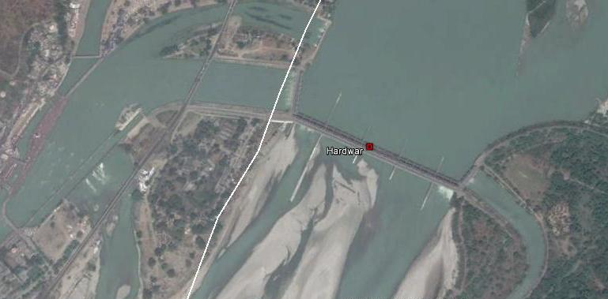
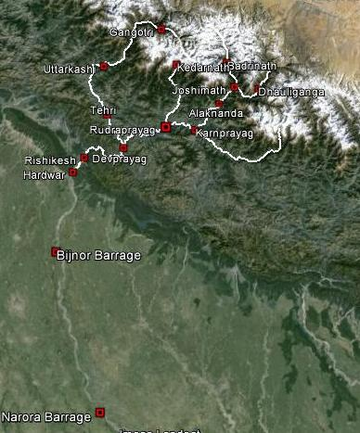
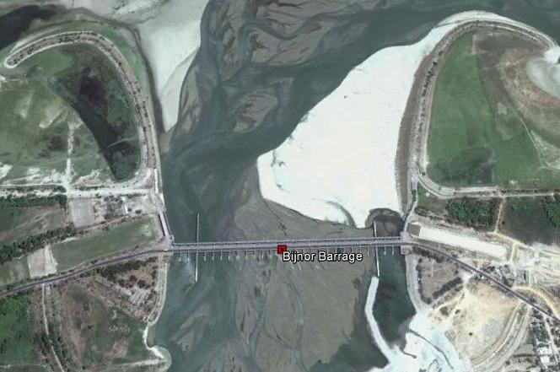
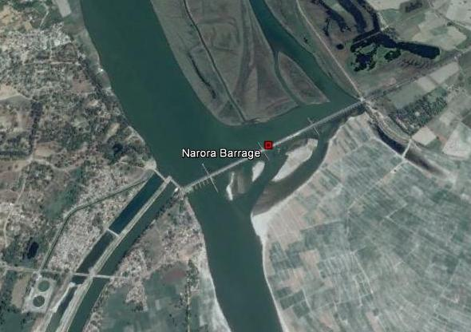
Consumptive use of Ganga water

Slide 15
Monthly % diversion of Ganga water from Hardwar
Irrigation potential created up to year 2012-13 – 6.99 lakh ha
Ganga canal – 297.35 cumec (Kharif ) with a cushion of 41.50 cumec future provision)
- 164.25 cumec (Rabi)
Eastern canal – 164.25 cumec (Kharif only)
Upper, Middle and Lower canal – 21 districts-5.14 crore population
Month | Average Diversion (%)
January | 76
February | 75
March | 79
April | 76
May | 57
June | 41
July | 18
August | 12
September | 17
October | 25
November | 60
December | 73

Slide 16
Flow dependability of Water Resources Projects
Type of Project | Flow Dependability or Exceedance Probability in Percent | SimulationTime Unit
Irrigantion Project without pondage | 75 | Instantaneous discharge every day
Irrigation project with pondage | 75 | 1 day to 10 days
RoR HE Project | 90 | 10-daily
Drinking Water and industrial water | Nearly 100 | daily

Slide 17
E-flows recommendations of different studies
Sub-committee on “Minimum Environmental/ Ecological Flows in Rivers” under the chairmanship of Member(RM), CWC
An allocation of 10 to 20 percent of MAR temporally distributed as per natural FDC (derived based on runoff data series available upto 1990) may be reserved for environmental needs of Himalayan rivers
Alaknanda-Bhagirathi basins Study –AHEC, IIT- Roorkee
The environmental flow assessment based on EMC-HMD approach lies between 5 to 25 percent of MAR (mean annual runoff)
Research Report 107- International Water Management Institute (IWMI)
EWR estimates (% natural MAR)
Class A | Class B | Class C | Class D | Class E | Class F
67.6 | 44.2 | 28.9 | 20.0 | 14.9 | 12.1
River ecosystems may, in principle, be maintained in a reasonable state even with 10-20% of natural MAR

Slide 18
IIT Consortium Report
Upper Ganga
40 to 75 percent of natural flows during lean period (January and February). During wet period, the recommended e-flows varies from 29 to 36.5 percent of natural flows. Overall, about one third of natural flows are recommended for e-flows annually
Other Ganga Segment-Recommendations are based on WWF study
The recommended E-flows at various locations have expressed as a percentage of natural Mean Annual Runoff (MAR). The recommended E-flows varies from 45 percent to 72 percent of MAR in normal year. During drought years, recommended E-flows varies from 14 to 44 percent of MAR
Major concern
Considering average non-monsoon monthly diversion of about 75% of Ganga water from Hardwar for Agriculture and drinking water how the recommendations for other Ganga Segment can be implemented?

Slide 19
Report of Inter-Ministerial Group on Upper Ganga
Period | Recommended e-flows
May-September | 25 % of daily uninterrupted flows in the river with the stipulation that the total inflow in river would not be less than 30% of the flows in the season
April, October and November | 25 % of daily uninterrupted flows in the river
December-March | 30% of daily uninterrupted flows in the river with 50% of flows for such rivers where the average monthly river flow during lean season (December-March) is less than 10 % of the of the average monthly river flow during high flow season (May-September) and 40 % where the average monthly river flow during lean season (December-March) is between 10-15 % of the of the average monthly river flow during high flow season

Slide 20
Alaknanda-Bhagirathi basins Study - Wildlife Institute of India (WII)
Environmental Flows required in the Alaknanda and Bhagirathi basins only for the dry zone of HEP has been estimated based on (i) Environmental Management Class of the rivers and (ii) Ecological requirement of fishes.
Environmental Flow Required (cumec) to sustain riverine ecology with special reference to fishes in the dry zones of HEPs in the Alaknanda and Bhagirathi basins based on ecological requirements of fishes was calculated as 20% of monthly average of flow during dry season (November to March), 25% of monthly average of flow from October and April, and 30% of monthly average of high flow season from May to September

Slide 21
Chopra Committee Report
The committee recommended E-flows of 50% during the lean season and 30% during the remaining non-monsoon months till such time as a decision is taken on the E-flows by IITs-consortium

Slide 22
Conclusions
The allocation of water for environmental needs should not be decided in isolation. A fine balance between development and environmental needs should be maintained.
Detailed study of each basin/sub-basin covering the ecological characteristics of river and E-flow requirements should be carried out.
There should be a well defined procedure for assessing the requirement of E-flows for any project during project specific EIA and EMPstudies.
Hydraulic rating cum habitat simulation methods may be applied initially to assess e-flow requirements. When data availability improves, other comprehensive methods such as holistic approach etc may be used.

Slide 23
Conclusions
As precise assessment of E-flows, being multi-disciplinary in nature, is still at evolving stage, broad allocations may be made based on the study carried out by WII i.e. 20% of monthly average of flow during dry season (November to March), 25% of monthly average of flow from October and April, and 30% of monthly average of high flow season from May to September.
There is urgent need to increase the irrigation efficiency in a phased manner to make more water available in river during the lean months
Considering the population and consumptive uses in Ganga basin, extra water in river during the lean months can be made available either by river interlinking or storing the surplus water during the monsoon.

Slide 24
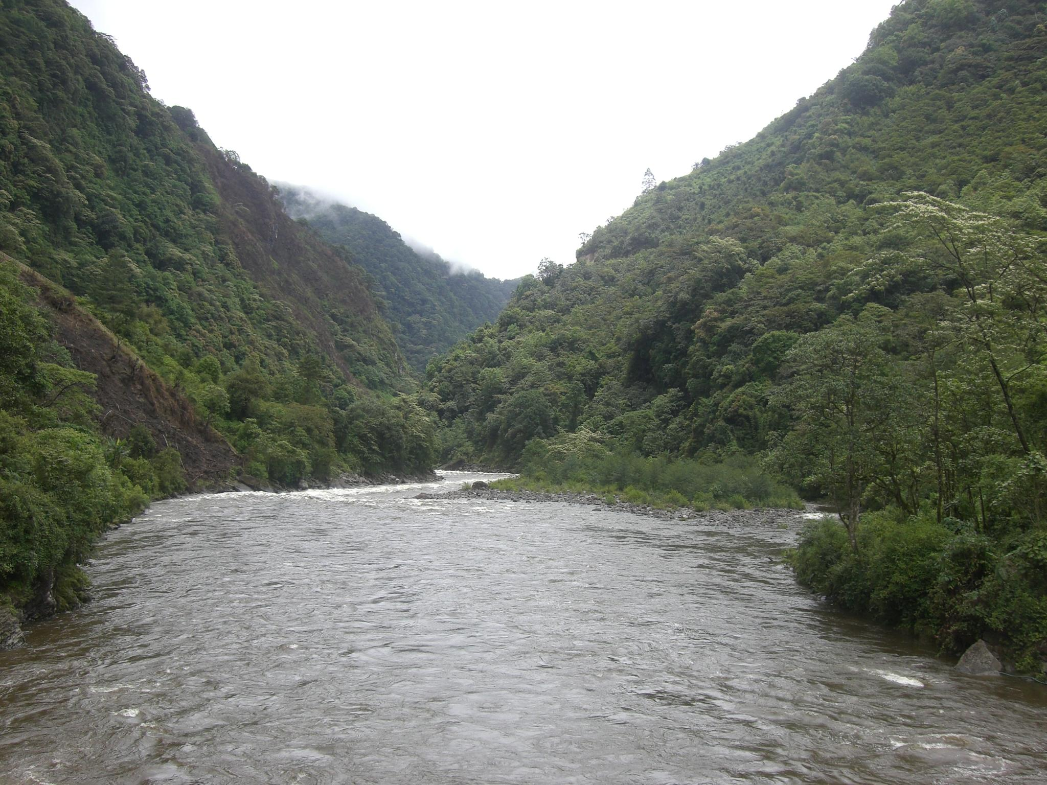
Thank You

